Slide 1
Digital Responses to Covid19
VMware

Slide 2
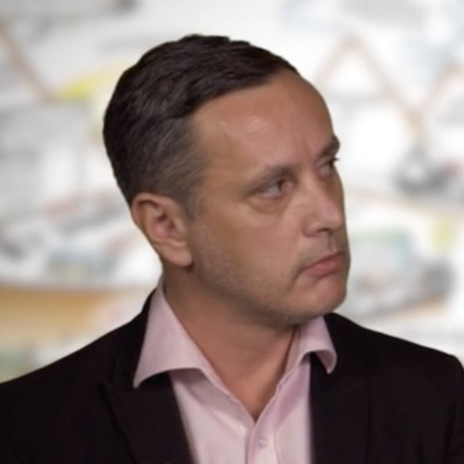


Who’s Who…
Spencer Pitts
Chief Technologist – Digital Mobility
Hema Purohit
Business Transformation & Healthcare Strategist
Darren Hirons
Senior Specialist – Digital Mobility

Slide 3















VMware Vision
Starting with Your Most Important Assets.. Your People
The Essential, Ubiquitous Digital Foundation
Any Worker
Any Device
Any Workstyle
Any Workplace
Any Application
Traditional
Cloud Native
SaaS
Any Cloud
Edge
Private
Hybrid
Public
Hybrid
Telco
Notes:
Any any any vision remains unchanged
Everything we do is building and executing against it
Each year – improving & refining but… the same
Let’s dive in and talk about “Any App on Any Cloud but also Any Worker, Any Workplace”…
<Click to Pop Any Cloud?

Slide 4






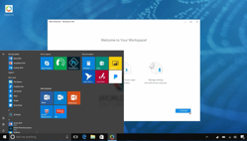





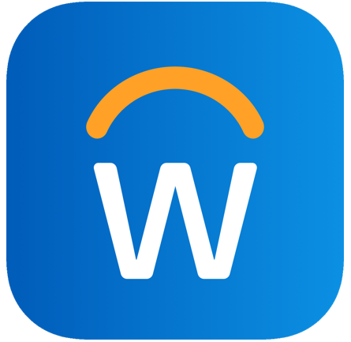
Continuity Timeline and Solution Mapping
Review process
All users & relevant Apps accessible
Review cost models and service levels
BAU
Next phase critical users Access
Expand App Portfolio & use cases
Expand Device type Access
Secure
Instant Secure remote working capability for critical Staff
Business Critical LoB Apps Access
Returning / Failback
New BAU
2-4 weeks
3+ Months
1st Week
1-3 months
Non-critical business function users – BYO?
Expand non-critical App access
Review Security
Develop new BC plan

Slide 5





Where to start…
Look for “easy wins” you can set up quickly
Rolling out a new cloud-based video conference system?
Easy
Granting external access to Physical Desktops
Easy
Setting up a brand new VDI environment from scratch?
Not Easy
Expanding an existing VDI environment for more users?
Relatively Easy
Building a brand new DaaS platform for additional user capacity?
Relatively Easy
Notes:
* Try to pick the right thing because you’ll have to deal with it for a long time.

Slide 6
Enabling Hybrid and Multi-Cloud VDI and App Deployments
New management services now available from on-premises to cloud
Control plane management services enter Beta and GA*
Simplify management using importing and automation techniques built in the cloud
Reduce complexity and overhead through hybridity
Horizon Control Plane
Management Console
Universal
Brokering
Image
Management
Application
Management
Monitoring
Horizon Lifecycle
Management
Session
Manager
Images
App
Packages
Infra Status,
Session Data
Installation,
Upgrade
On-Premises
VMC on AWS
Partner Solutions
Microsoft Azure
Horizon Universal License
Notes:
*Image management is in Beta for Horizon 7 on-premises and Horizon 7 on VMC on AWS
*App Management (SAM / AV 4.0) is currently Beta and going GA in Q4 for Horizon 7 on-premises and Horizon 7 on VMC on AWS
*Monitoring (Cloud Monitoring Services) is GA for all deployment options

Slide 7
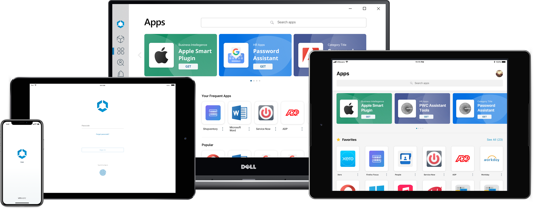



Looking to the future….Workspace ONE
Engaging employees to work from anywhere, on any device
Intelligent Hub features
People Search
Onboarding | App Catalog | Notifications
People | Home | Mobile Flows
Home page
Notes:
In October of 2018, Vmware announced the GA of the Intelligent Hub mobile experience to support engaging, productive experiences for employees. Now, we have added the same capabilities and released all new desktop and web apps to support a single consistent experience for employees. In addition, we have added platform optimizations to ensure the best experience on every device. For example, only highlighting virtual apps on devices whose form factor is large enough to interact with the app. Also, native software installation for Mac and Windows tying into the initial setup – concept that isn’t necessary on mobile today.

Slide 8
What Next?
Further Information
https://www.vmware.com/
  Business Continuity
https://www.vmware.com/solutions/business-continuity.html?src=WWW_US_HPH0_BusinessContinuity_SiteLink
Roadmap to Remote
  Develop a tangible plan to get from ‘here and now’ to ‘there and future’
Spencer Pitts
(E) spitts@vmware.com
(M) +44 7872 676 221
Hema Purohit
(E) purohith@vmware.com
(M) +44 (0) 7775 715649
Darren Hirons
(E) dhirons@vmware.com
(M) +44 (0) 7766758654

Slide 9
Questions?

