Slide 1




NHSX COVID clinical cell update
Gareth Thomas, Dave Lambert and Lisa Hollins

Slide 2
Clinical overview
Workstream | Description
Testing
Virus IT testing | Digital support for testing including virus and antibody testing
Online Direct Care
Online assessment tools | 111 Online, VC for secondary and primary care, Isolation notes, automated assessment and physiology and VC for 111 assessment
Digital Urgent & Emergency Care - Clinical Pathway | Activities, oversight & assurance of UEC live service working with NHSD, NHSE, UEC & PHE
Covid19 Clinical Assessment Service Queue | Provision of specific queue within 111 for a cohort of Covid19 patients requiring clinical assessment, from Online and Telephony.
NHS workload reduction
Workload reduction: Community care | Equipping Pharmacy, Optometry and Dentistry (POD) sectors with the necessary technology needed to support Covid19 response
General Practice Remote Working | Technology for remote working: Ensure every GP practice has the capacity to support remote working for staff including equipments, secure communications, smartcard access, software and access to support.

Slide 3
Clinical overview
Workstream | Description
Citizen-facing services
Digital products and content coordination | Cross Govt co-ordination of commissioning of digital content and new digital services and tools
National digital products accelerated delivery | Accelerate delivery of NHS App’s functionality to support the Covid-19 effort, create Covid-19 content on NHS.UK and integrate NHS App, NHS.UK and NHS Login.
SMS to symptomatic self isolators | Offering citizen facing advice and SMS messaging as well as allowing people with Covid-19 symptoms to notify the NHS by text
Digitally-enhanced services
National data sharing | Summary care record with additional information and GP Connect
Digital Medicines | Ensuring that the existing digital prescription services are implemented and utilised as widely as possible (EPS) and access to electronic prescribing data from secondary care is accelerated

Slide 4
Progress since our last meeting
NHSX has worked in close partnership with NHS England and Improvement, NHS Digital and NHS BSA to deliver the following milestones
Over 1.2 million isolation notes generated (4/5/20)
eConsult service available on NHS App now live with over 2,700 practices (1/5/20)
For upcoming stage of laptop deployment, over 21,000 have been delivered to local IT services for deployment to general practices for primary care (30/4/20)
GP Connect switched on for general practices across England
Over 400,000 Coronavirus users for 111 online this week (week ending 3 May)
Backlog in verification for NHS Login reduced to 2 -3 hours, enabling faster access to the NHS App (29/4/20)
Sent a combined total of 22,000 text messages to symptomatic self-isolators with <1% drop out rate per day
The Clinical Advisory Group has been formed to lead clinical projects and to act as a hub, where other teams within NHSX can access clinical advice in relation to digital technology.

Slide 5
111 Clinical Assessment Service
The aim of the Covid-19 Clinical Assessment Service (CCAS) is to enable 111 telephony and 111 online patients displaying Covid-19 symptoms to be allocated to a specific queue where the clinical assessment can be prioritised. Working with NHS Digital, South Central Ambulance Service, and South Central and West CSU, the CCAS was implemented on 27/03 and returning GPs commenced the support of the service on 01/04.
Assumed COVID case flows in-hours
NHS 111 Entry Point
Online &
Telephony
Cohort 1
Ambulance
Cohort 2
Covid Clinical Assessment Service (CCAS) or local services as appropriate
Prioritisation List via GP Connect
Patient’s GP practice to manage
4
Cohort 3
Home – self-isolate

Slide 6
111 Clinical Assessment Service
Progress so far:
Procured licences (Advanced Adastra) and implemented a 111 queue to provide covid-19 clinical
assessments by phone
Stood up process to allow NHS staff to work for 111 remotely and to provide equipment for returnees
Over 750 GPs onboarded
Over 24,000 clinical assessments made since the service went live, up until 29/4/20
Current functionality:
Transfer into CCAS from 111 Online and 111 telephony
Ability to request the dispatch of an Ambulance
Directory of Services access
Can notify GP of encounter
Can record patient encounter
Appointment booking via GP Connect
Access to PDS
Access to CPIS
Next Steps:
Development of functionality for access to Electronic Prescription Service
Consider use of video conferencing in CCAS - discovery work to commence
Supporting equivalent Clinical Assessment Services for both Pharmacy and Dental
Retrospective review of existing functionality

Slide 7
Remote monitoring
Supporting patients during the acute phase of COVID-19
Remote monitoring of patients will be an important way of delivering care and will support the following digital pathways in long term conditions and monitoring of at risk COVID19 patients. During the pandemic - services are required to:
Monitor the progression of people at home with COVID-19 symptoms without increasing the physical demand on the acute or primary care sector, so that patients receive hospital care at an appropriate time.
Remotely monitor recovering COVID-19 patients following discharge from hospital,
so that they can continue to give support while being informed of disease progression.
Remote monitoring to enable a 'Community Virtual Ward'
Rapidly identify deteriorating patients who have COVID-19 symptoms
Provide greater clinical support and oversight of care at home
Enable clinicians to react faster, avoid further complications and better manage system capacity
Improve both patient experience and overall survival.
Ongoing work is taking place to scale across COVID19 hotspots.

Slide 8
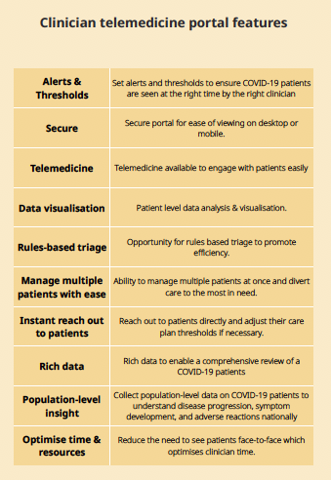
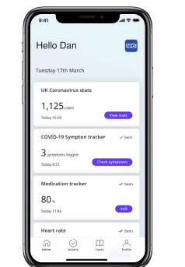
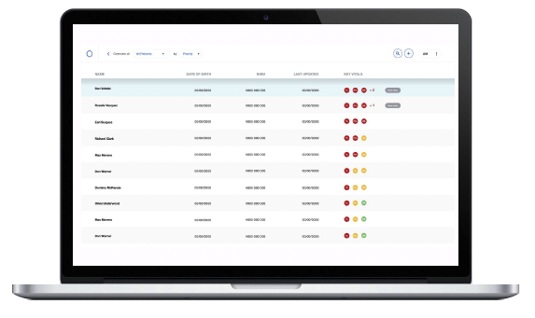
MVP | Initial tech solution
Fast to setup, flexible configuration, simple to use, free
Patient app to report COVID-19 symptoms and baseline clinical metrics
HCP dashboard portal to review and triage treatment
of COVID-19 cohort

Slide 9
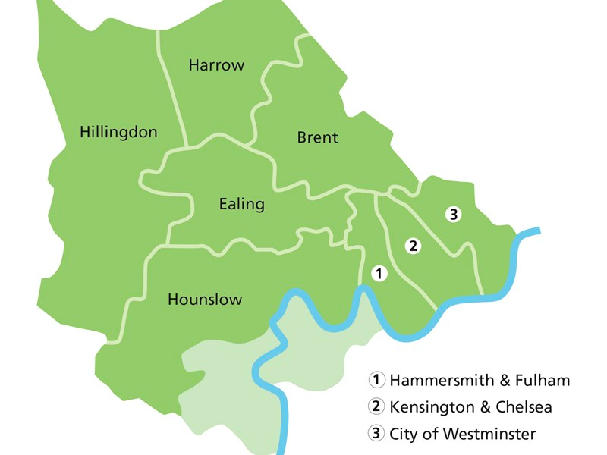
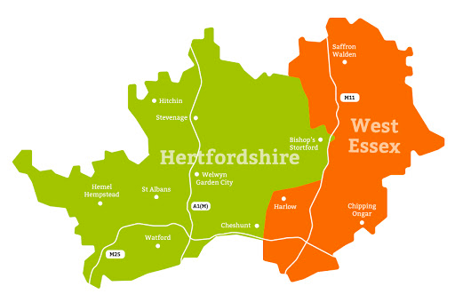



MVP | Priority roll-out sites
Primary Care
North West London CCG
COVID-19 HOT HUBS:
MVP Hillingdon and Central “hot hubs”
Secondary Care
Herts Valleys CCG
WATFORD GENERAL HOSPITAL

Slide 10
Benefits
PATIENTS
CLINICIANS
1. Improved patient experience & virtual support
2. One place to be reminded of when to regularly record data about symptoms, & agreed vital signs (temperature, oxygen sats, heart rate).
3. Ability to record oxygen saturation using a peripheral pulse oximeter
4. Access to video consultation should the patient require follow up & reassurance without travelling to a face to face consultation.
1. Supports recognised clinical pathways in community settings
2. Real time access to patient recorded data, via a clinician dashboard where a full list of patients can be viewed
3. Automatically prioritised view of patients based on vital signs to aid rapid triaging of patients
4. Clinician can video call patient directly from the platform where a consultation is required

Slide 11
Remote monitoring - deployment and initial findings
Initial approach from clinicians in Hertfordshire requesting help for remote management tools for their virtual ward
Rapid agreement from NHSX SLT to select this product and move quickly to test, build plan and contract awarded
On 24 April: Product went live in all 3 first sites, Watford General Hospital, Hillingdon and Central London “Hot Hubs”
Initial soft launch to test Clinical Pathways, ensure on-boarding processes worked successfully and trial the app
As of 28 April: 27 patients enrolled in the programme with the tool already flagging 4 patients needing intervention
10 patients enrolled in the Hertfordshire site; 17 patients enrolled across 2 North West London sites, growing daily
All the sites have also discharged patients following a short monitoring period using the tool and are training more clinicians
4 interventions as a direct result of abnormal results being submitted (heart rate and oxygen saturations) - none needed transfer to hospital
Building a plan for scale across London in first instance
Patients and clinicians like using the tool. Patients like that they are notified by ✔️✔️ when a clinician views their data.
London looking at wider scaling into another 6 Hot Hubs, as well as initial conversations with Acute trusts.
Hertfordshire is issuing to staff who attend drive-through screening clinics and meet the criteria for support
All the sites are looking at how a similar tool might support pathways post COVID-19.
NHSX team have received queries from other areas looking at remote monitoring tools for COVID-19 and beyond.

Slide 12
Our questions to the network
As we review the strategic direction of the CCAS, are there other examples of where a national Clinical Assessment Service may be effectively used?
As we look to extend remote monitoring across England, are there examples of best practice or opportunities that we should be made aware of?
Upcoming work:
We will be publishing a survey of digital channel shift and video consultation via the Network

