Slide 1


Future vision for the expansion of the Digital Academy: A focus on people and lifelong learning
Digital Health Webinar, 26th June 2020 with:
Health Education England
Surrey & Borders Partnership NHS Foundation Trust
South, Central & West CSU (commissioned by HEE)

Slide 2



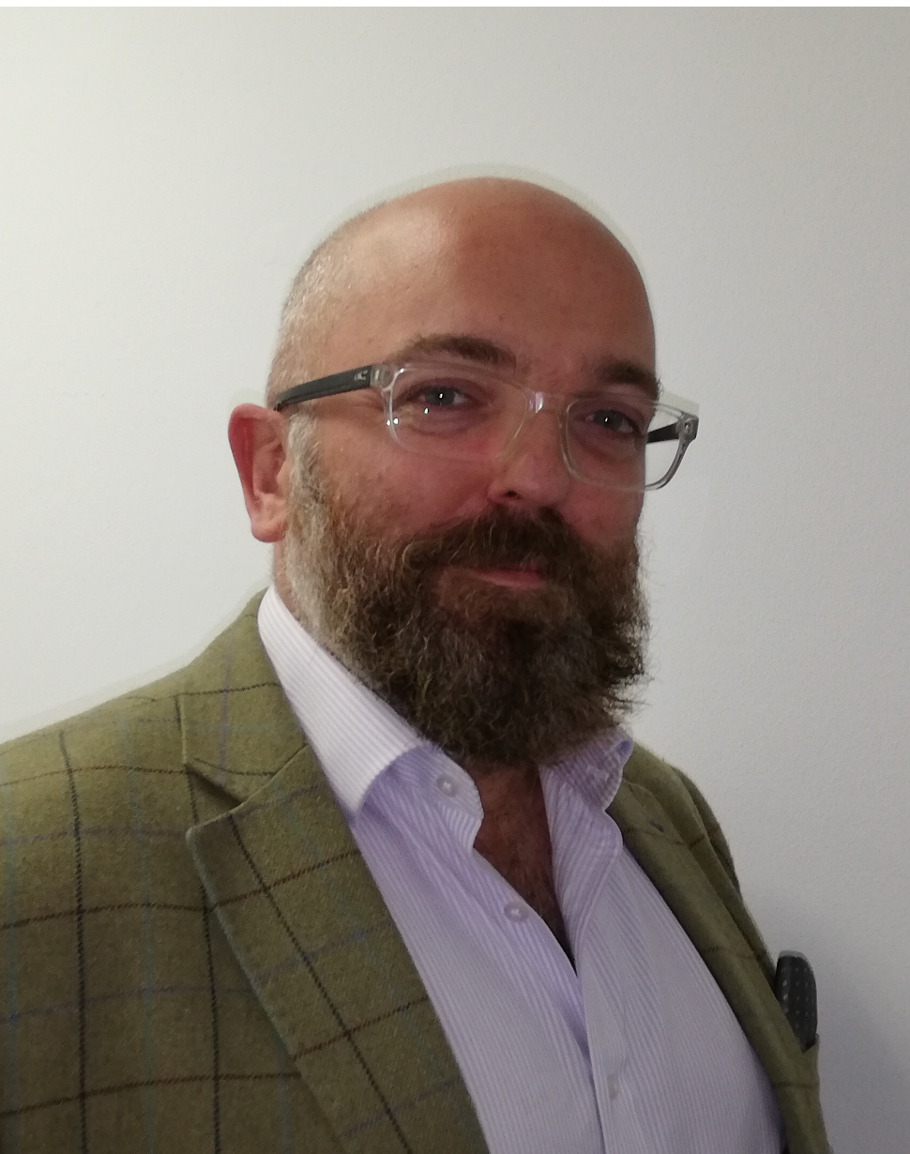
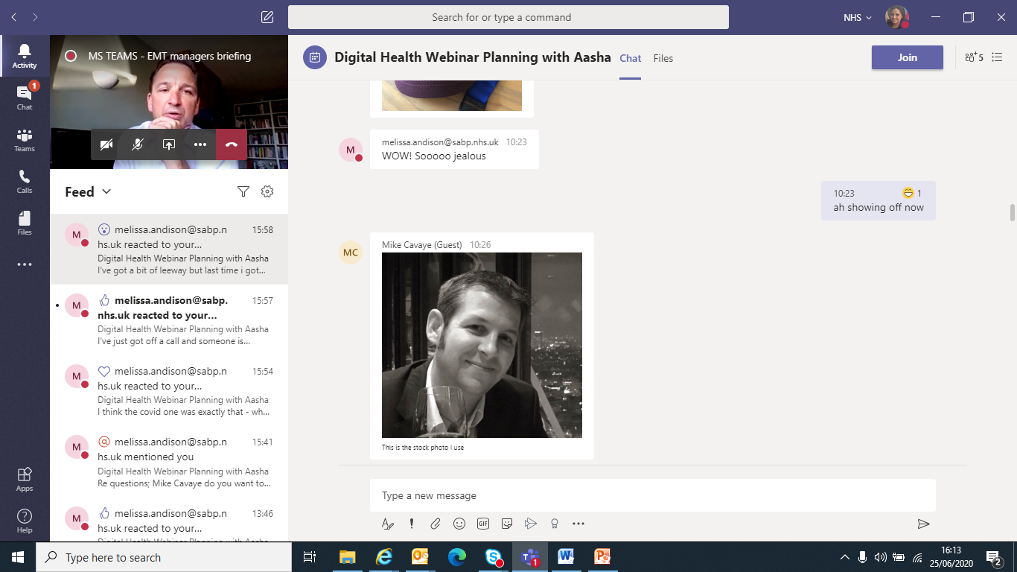
Meet the presenters & panelists
Aasha Cowey
Programme Manager, SCW
David Farrell
Head of Digital Readiness, HEE
Melissa Andison Associate CCIO, SABP
Doug Stewart
Director of Digital Health & CCIO, SABP
Mike Cavaye
Deputy CIO, SABP

Slide 3
History of the NHS Digital Academy
Secretary of State commitment following Wachter Review (2016), with the aim to support, nurture and develop digital leaders.
Imperial College London (as lead, working with Edinburgh & Harvard Universities) awarded contract following open procurement to deliver Post Graduate Diploma for Digital Health Leadership. This learning programme forms what is essentially the NHS Digital Academy.
Current contract is 300 delegates (3 cohorts of 100 people) to complete 12 month learning programme. Positive evaluation by the NHS Leadership Academy and intention to re-procure the learning programme with a view to be able to commence a ‘Cohort 4’ from September 2021. There is no extension option in the current contract.
This re-procurement process has commenced at HEE and will be via open competition, taking place through the next few months (anticipating tender out early July).The evaluation, and other drivers such as the interim People Plan, has highlighted the need to specifically include some additional aspects in the next contract, such as the alumni network and the ability to re-use/extend the use of learning.
Any queries on the re-procurement to David Farrell: david.farrell@hee.nhs.uk

Slide 4







Postgraduate Diploma in Healthcare Leadership (Imperial & Partners)
Generally a positive
experience increasing participant confidence about their abilities
Cohort 1 – 100%
pass rate
Building new networks
Contributing to digital professionalism
International interest
Market demand – current offering oversubscribed
Rapid adaptions to feedback

Slide 5




Why do we need a future vision?
  Ensure alignment with mainstream NHS leadership including board development
  Build a strong and diverse talent pipeline
Co-ordinate opportunities linked to professionalism
Develop a long term delivery model
  The scope of the work has been to articulate a vision for what the expansion of the NHS Digital Academy should look like. This is therefore broader than the current learning programme on offer under the NHS Digital Academy brand.

Slide 6











Operating within a broader context
Postgraduate Diploma in Healthcare Leadership (Imperial College London & Partners)
National infrastructure in place with successful informatics skills development networks in the North West and Yorkshire & Humber
AphA, BCS, CILIP, IHRIM & SOCITM are working together to support professionalism in Health Informatics through FEDIP
FCI: Multi-disciplinary professional body for clinical informaticians, supporting people at all career stages
OneHealthTech (launched 2015) - grassroots community that supports and promotes underrepresented groups to be future leaders in health innovation
Shuri Network (launched 2019) - first NHS network of Black Asian & Minority Ethnic (BAME) women in health tech and digital health
Minverva Womens
Leadership Programme launched in 2019
UK access to the CHIME Healthcare CIO qualification (CHCIO)
via BCS
Graduate Management Training Scheme expansion includes Health Informatics & Health Analysis specialisms
‘Digital In A Day’ board development sessions developed with rollout planned
Expansion of the Graduates into Health IM&T Scheme into three regions

Slide 7
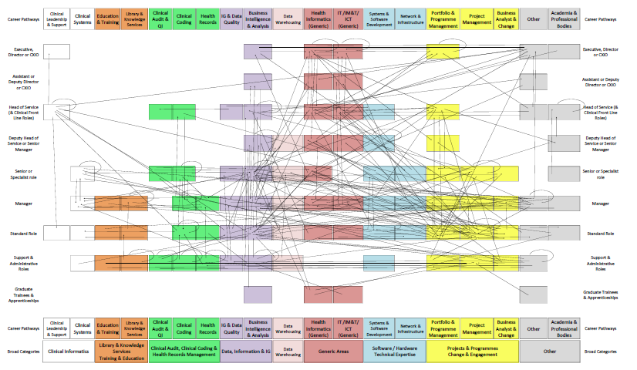
How do we do this without career pathways?
Career taxonomy to segment the workforce
Because the last attempt to map career pathways………
Board Level
Specialist Digital, Data & Technology Roles
Digital Change
Leadership
Entry Level Digital, Data & Technology workforce
Wider workforce

Slide 8




The impact of COVID: A new future?
Engagement approach adapted (which we must acknowledge)
The NHS has undergone rapid digital transformation
The barriers to the workforce are changing? Less about basic infrastructure, more on culture?
An opportunity to learn and reflect

Slide 9
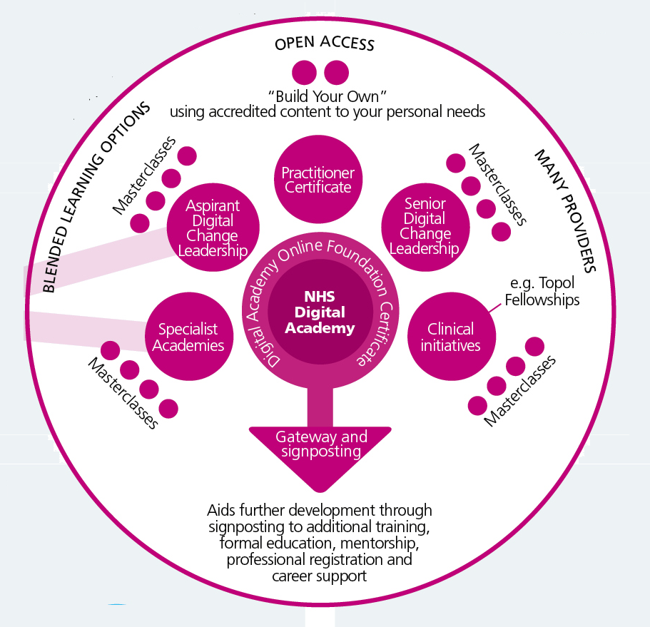
Future Vision: Principles
Home for digital learning
Blended learning approach
Ready made schemes, or build your own. Take individual modules & masterclasses
Addresses current gaps but signposts where more appropriate
Multiple providers
Individuals earn badges/credentials

Slide 10

Are we missing some basics?
Enable individuals to have access to some basic training across digital, data and technology with an Online Foundation Certificate
Open access
Cover key areas
Use storytelling
Reduce silos: increase basic knowledge of other teams
Expansion to practitioner?
Enable individuals to have equal opportunities and access to resources, as well as making informed choices about what to use. This may include signposting to a range of things including:
Additional training
Formal education
Mentorship & networks
Professional Registration
Career Support

Slide 11
Expanding the Digital Change Leadership offering
Traditionally this has been aimed at CIO/CCIO level
Recommission the current learning programme but consider a senior programme and an aspirant programme to enable focus
Over time enable individuals to pick different levels of modules based on their needs in specific areas
Continue to work with high quality academic providers – but maybe more options
We need to understand alignment to entry level better: graduates and school leavers – and how can they benefit from the learning programmes?

Slide 12
Development of Specialist Academies
  The content from the Digital Change Leadership learning materials should be sharable, accessible and reusable wherever possible.
  Specialist academies could focus on the needs of particular groups – where they may need something a bit more specific. This could include:
  More specialised roles e.g. analysts or library & knowledge professionals
  The needs specific clinical roles may have
  Currently exploring the use case for social care roles
  Should follow the same approaches i.e. blended learning, build your own.

Slide 13


How do we prioritise learning content?
Validate it is what the workforce want and this should include understanding what existing participants have found the most useful to embed organisational change so far.
Ensure content can use powerful storytelling and case studies to truly get across the impact digital, data and technology can have on frontline health and care.
Alignment to national policy where possible so the workforce are equipped with the relevant skills and knowledge for the current challenges.

Slide 14
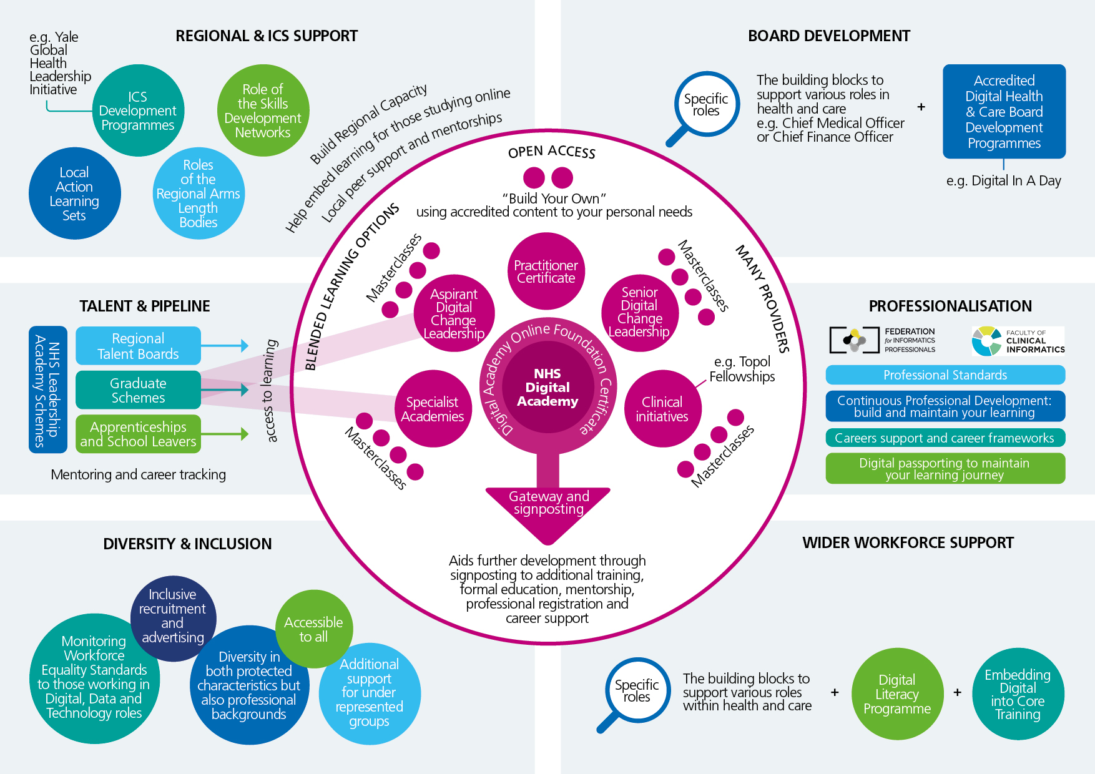
A future vision (within the wider landscape)

Slide 15

Diversity & Inclusion

Slide 16
What do we want to achieve from further engagement?
Consultation with the digital, data & technology workforce to confirm that this vision is what they want, any gaps and missed opportunities, and subsequent refining of the vision.
Targeted stakeholder engagement to explore and strengthen collaborations with others including social care, regional teams and regional talent boards, graduate schemes, informatics skill development networks, the four nations, academia and professional bodies. This should include exploration around accreditation and branding.
Projects to explore key areas including mentoring, diversity & inclusion, case study development.
Development of an implementation plan co-produced with key stakeholders including previous and future participants of key learning programmes. This implementation plan should provide medium and long term recommendations.

Slide 17
How to engage and contact details
Please visit the engagement platform to download the vision documents and give us your feedback:
https://jointheconversation.scwcsu.nhs.uk/digital-academy-future-vision
Contact
For future vision work: aasha.cowey@nhs.net
For current reprocurement: david.farrell@hee.nhs.uk

Slide 18
www.scwcsu.nhs.uk

